Slide 1
Frontend Web Dev (Master Class)
By Talha Tariq
Make your living online by learning a high income skill.

Slide 2
HTML
Hyper Text Markup Language

Slide 3
How to Make Website
Make a Text File
Change the extension to from .txt to .html
Write Something
You’re done with your first website.

Slide 4
How to Make Website
A website consists of three parts:
  HTML
  CSS
  JavaScript

Slide 5
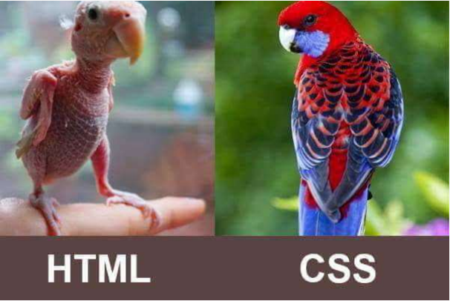
Parts of Website
Part of Webs

Slide 6
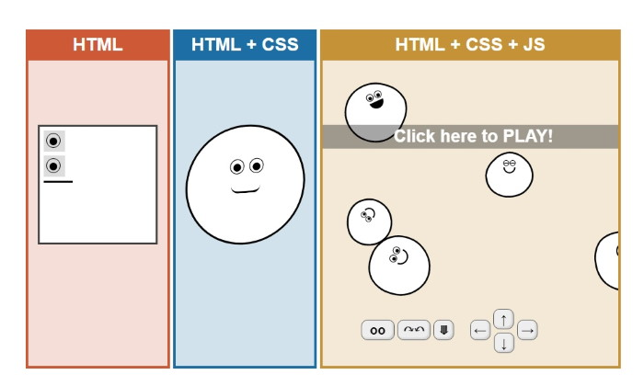
Parts of Website
In a website, HTML is the structure, CSS is the style, and JavaScript is the functionality.
Each website must contain HTML and CSS.

Slide 7
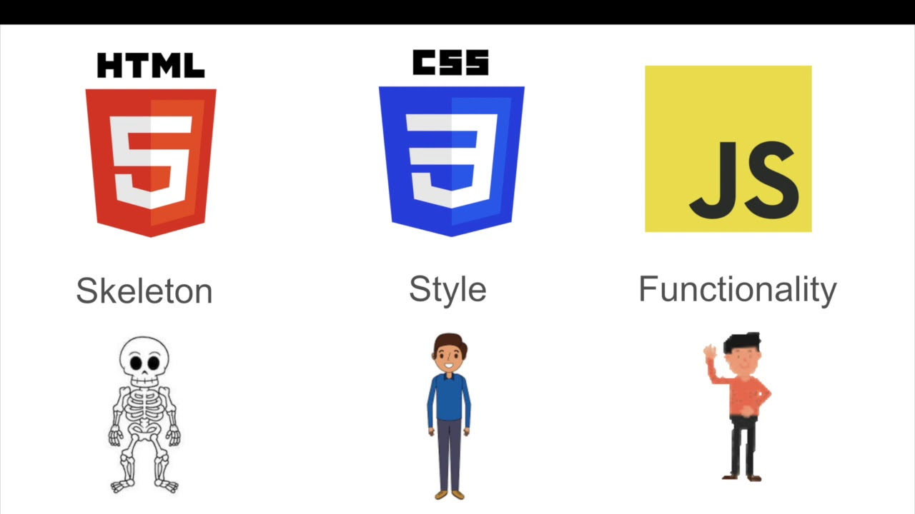
Parts of Website
Part of Webs

Slide 8
HTML
HTML stands for Hyper Text Markup Language.
This is the displayed content on the website.
HTML is a fundamental building block of a Website.
Try to see content of a website using Inspect Element.

Slide 9
HTML Structure
HTML file saved with the extension of .html or .htm
Inside this file, we organize the content using tags.
Tags wrap the content, and each tag gives a special meaning to the text it wraps.
When an HTML page is served by the browser, the tags are interpreted, and the browser renders the elements according to the rules that define their visual appearance.

Slide 10
HTML Structure
Things start with the Document Type Declaration.
  <!DOCTYPE html>
  Then we have an <html> element with opening and closing tags.
  Then we have an <head> and <body> tag with opening and closing tags.
  Inside head we will have tags that are essential to creating a web page, like the title, the metadata.
  Inside body we will have the content of the page. The visible stuff.

Slide 11
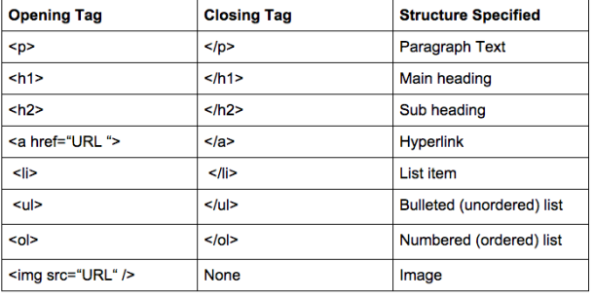
Tags
Most used & common Tags are these

Slide 12
Nesting Tags
Nested elements are elements that have other elements in them.
Example:
<p>Full Stack Bootcamp by <strong>DiaaTech</strong> is ongoing </p>
Result:
Full Stack Bootcamp by DiaaTech is ongoing

Slide 13
Attributes
All HTML elements can have attributes
Attributes provide additional information about elements.
Attributes are always specified in the start tag.
The starting tag of an element can have special snippets of information we can attach, called attributes.
Attributes have the key="value" syntax.

Slide 14
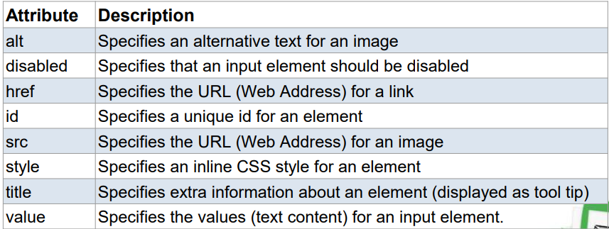
Common Attributes

Slide 15
Div Tag
  The <div> element is used as a container that divides an HTML document into sections and is short for “division”.
  <div> elements can contain flow content such as headings, paragraphs, links, images, etc

Slide 16
Lists
There are three types of Lists
  Unordered lists
  Ordered lists

Slide 17
Forms
Forms are the way you can interact with a page, or an app.
When you click submit button, data will be send to server.
Form is created using <form> tag.
Form can have multiple elements like.

Slide 18
Forms Tags
Forms can have multiple tags like
  Input Boxes
  Text Areas
  Select and Check Boxes
  Buttons
  File uploads

Slide 19
Input Tag
Most widely used elements of form.
A versatile element which can change behavior.
Type of input tag can be
  Text
  Number
  Password
  Email
  Submit
  We can place default value in a Form.

Slide 20
Input Tag
We can set field as required.
Some other types
  File
  Button
  Radio Button
  Check Boxes
  Date

Slide 21
Text Area Tag
  The <textarea> element allows users to enter multi-line text.
  We can set dimensions of Text Area.

Slide 22
Select Tag
  This tag is used to create a drop-down menu.
  The user can choose one of the options available.
  <select name="color">
  <option value="red">Red</option>
  <option value="yellow">Yellow</option>
  </select>

Slide 23
Let’s Play
  Project 1: Portfolio Website
  Project 2: Registration Page
  Project 3: Product Blog

Slide 24
Let’s Play
Assignment

Slide 25
CSS

Slide 26
Let’s Recap

Slide 27
Introduction to CSS
CSS is used to control the style of a web document in a simple and easy way.
CSS stands for Cascading Style Sheets.
CSS is a simple design language to make to web pages presentable.
Using this, you can control color of text, style of font or the spacing between the paragraph and lines.
CSS provides a great advantage in term of re-usability.

Slide 28
How to Apply CSS?
There are three ways to style a web page using CSS.
  Embedded CSS
  Inline CSS
  External CSS
  We will use External CSS in the rest of this course.

Slide 29
Selector
CSS have. many style rules that are interpreted by the browser and then applied to corresponding elements in your document
A basic style rule is made of three parts:
  Selector : Tag on which style will be applied
  Property: Style which we want to change or customize (color, font etc)
  Value: Values are assigned to properties.
  Example:
  Syntax: selector { property: value }
  Use: h1 {color : “blue”}

Slide 30
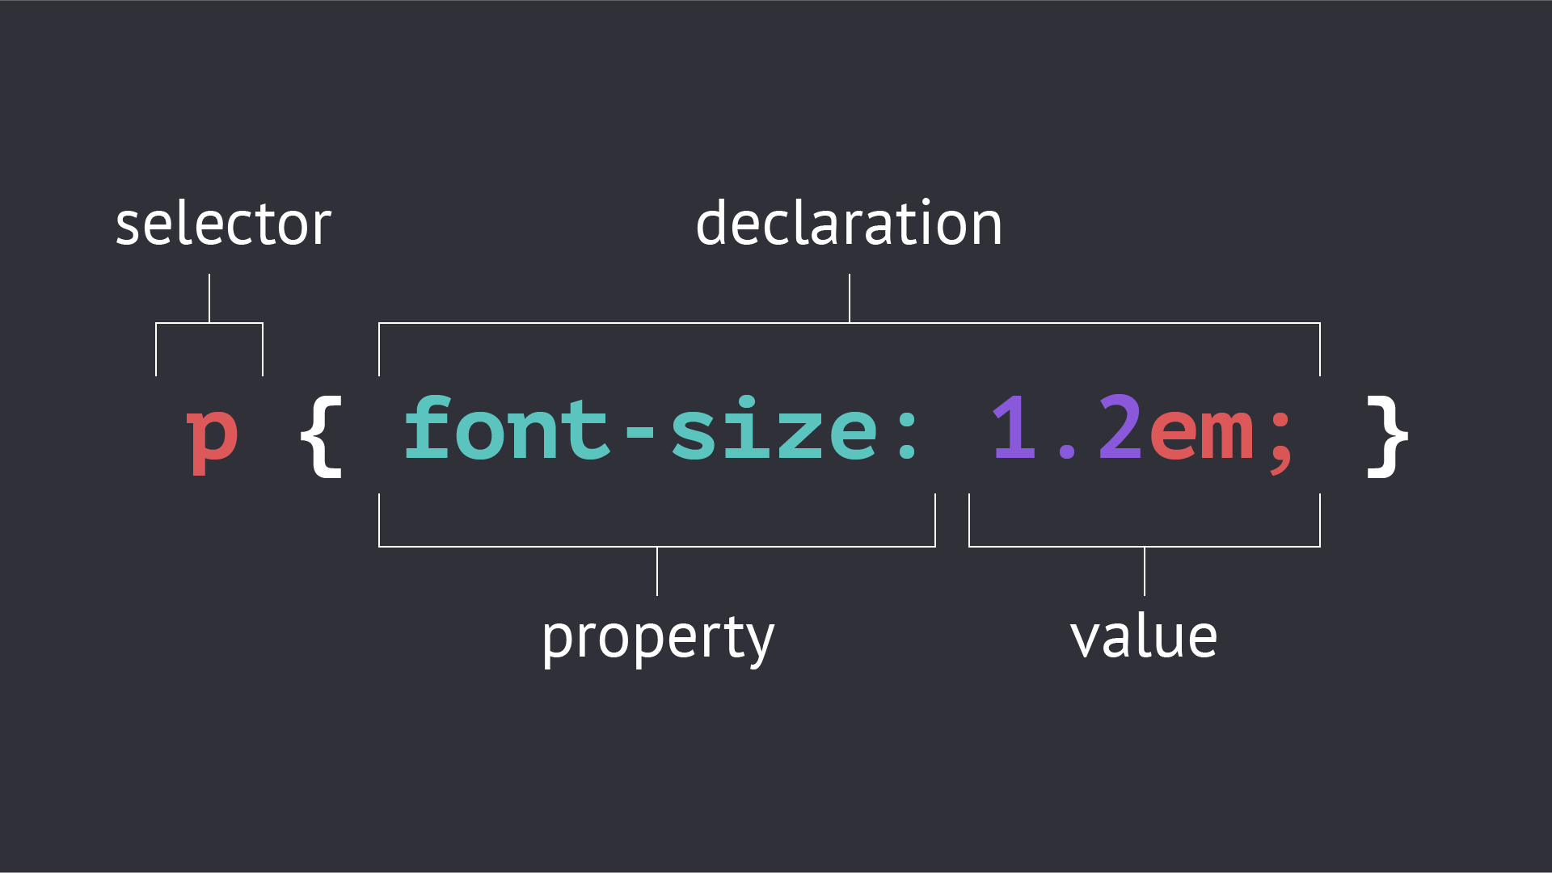
Selector

Slide 31
Types of Selectors
We can apply style using selector and we did this extensively in our previous slides. There are many types of Selectors.
  Universal Selector (*)
    Styles in that selectors applies to all the elements in the web page.
  Class Selector
    A most widely used selector in CSS.

Slide 32
Types of Selectors
  ID Selector (#)
    Used for styling of unique elements.
  Attributes Selector
    Applies style to a particular attribute of an element.

Slide 33
Types of Selectors
  Grouping Selector
    Applies same style to many elements.

Slide 34
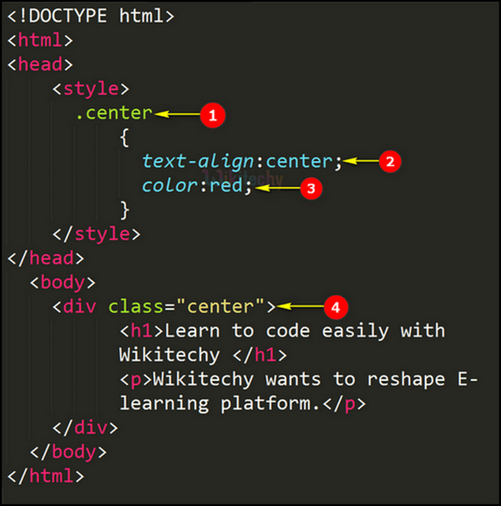
Types of Selectors
Class Selector
Need to assign a class to the element
And then have to apply style on that
Particular tag using that class.

Slide 35
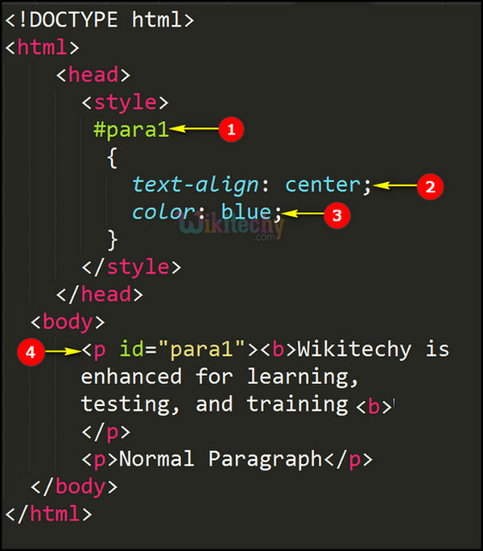
Types of Selectors
ID Selector
Need to assign an ID to the element
And then have to apply style on that
Particular tag using that class.
Difference?

Slide 36
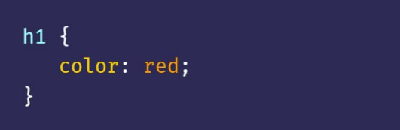
Types of Selectors
Tag Selector
Just have to select an tag and have to apply
Style on it.

Slide 37
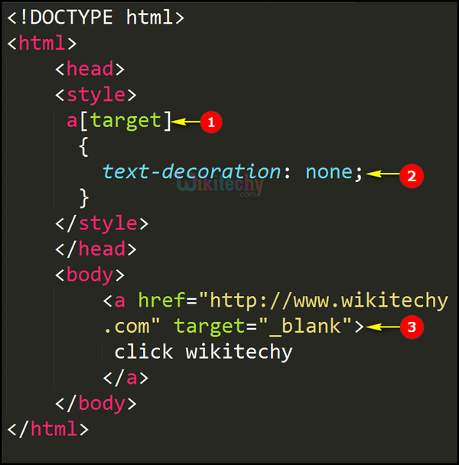
Types of Selectors
Attribute Selector
Just have to target element with that attributes
And style will be applied on it.

Slide 38
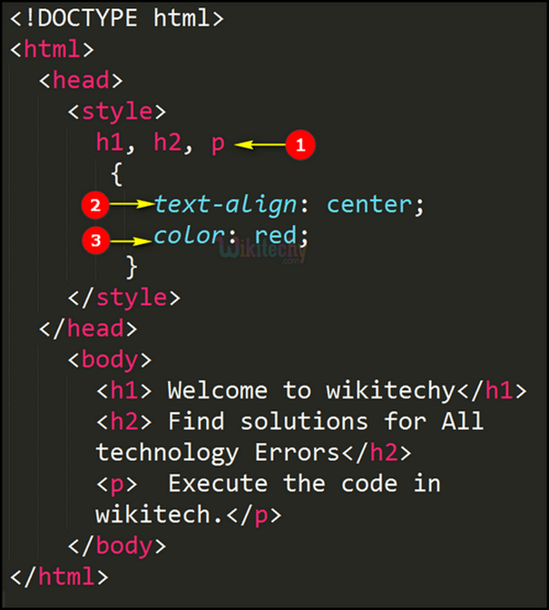
Types of Selectors
Grouping Selector
Have to target multiple selectors together,
And have to style them.

Slide 39
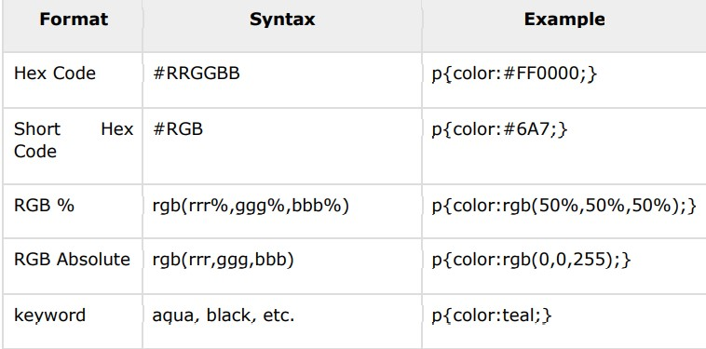
Color System
CSS uses color values to specify a color.
We can set both foreground as well as background colors of the text.
Colors can be set in various formats.

Slide 40
Typography
Some font properties in CSS:
  font-family
  font-size
  font-weight
  line-height
  text-align
  text-transform

Slide 41
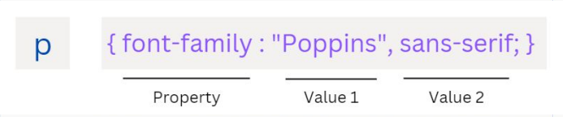
Font-family
Several values can be written so that if the font type at value 1 is not supported by the browser used, then there are alternatives at value 2, value 3, and so on.

Slide 42
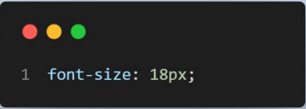
Font Size
We can define font size units with em, rem, px, mm, percentage, and so on.

Slide 43
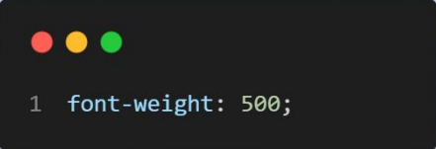
Font weight
The size of the font weight is determined by the numbers 100 to 900. However, the thickness of the text can also be specified by 'normal', 'bold', 'bolder' and 'lighter'.

Slide 44
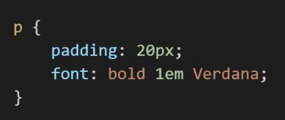
Shorthand
Shorthand of font-style, font-weight, font-variant, font-size and font-family, so that the writing of these properties can be shortened by using only one property.

Slide 45
Text
We can customize everything related to the text.
Property | Use
color | change color of text
letter-spacing | change space between letters
word-spacing | change space between words
text-align | Align text at a specific position
text-transform | For upper or lower case.

Slide 46
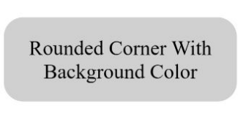
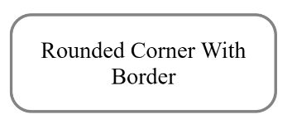
Shapes
Components with unique shapes can attract attention so they can be used for important elements.

Slide 47
Shapes
These properties are used for making shapes.
border-width | border-style | border-color | border | border-radius

Slide 48
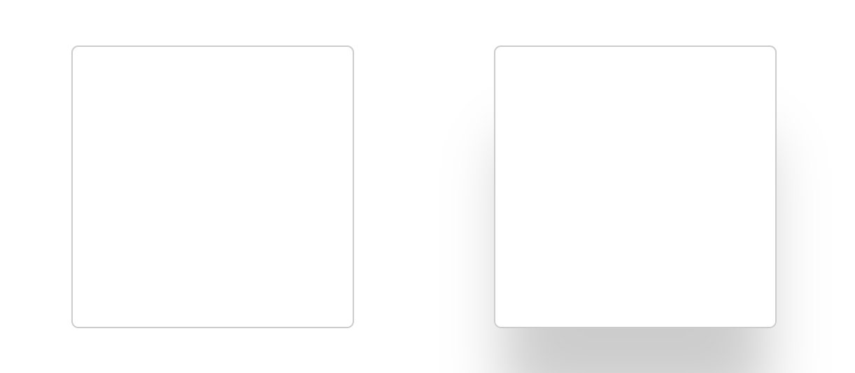
Shadows
For making the shapes and text aesthetic, we use the concepts of shadows.
It applies on both the shapes and texts as well.

Slide 49
Backgrounds
Colors & Images

Slide 50
BOX Model
Every Element (Tag) is wrapped inside an invisible box.
We can customize that box using some properties.
BOX model refers to the box of an element with properties.
We can create super elegant layouts using concept of Box Model.
Box model has properties of Margins, Paddings and Border.

Slide 51
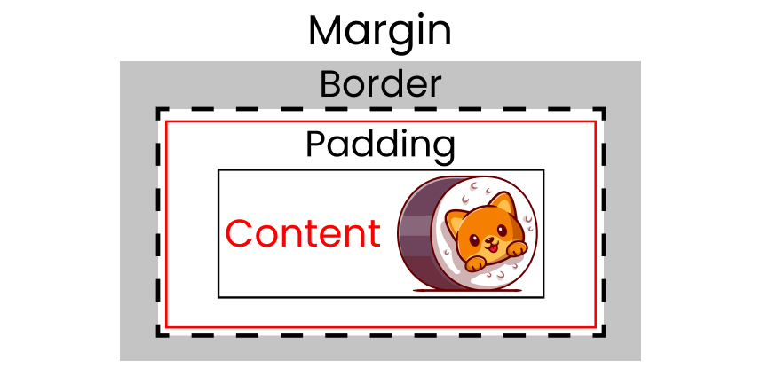
Box Model

Slide 52
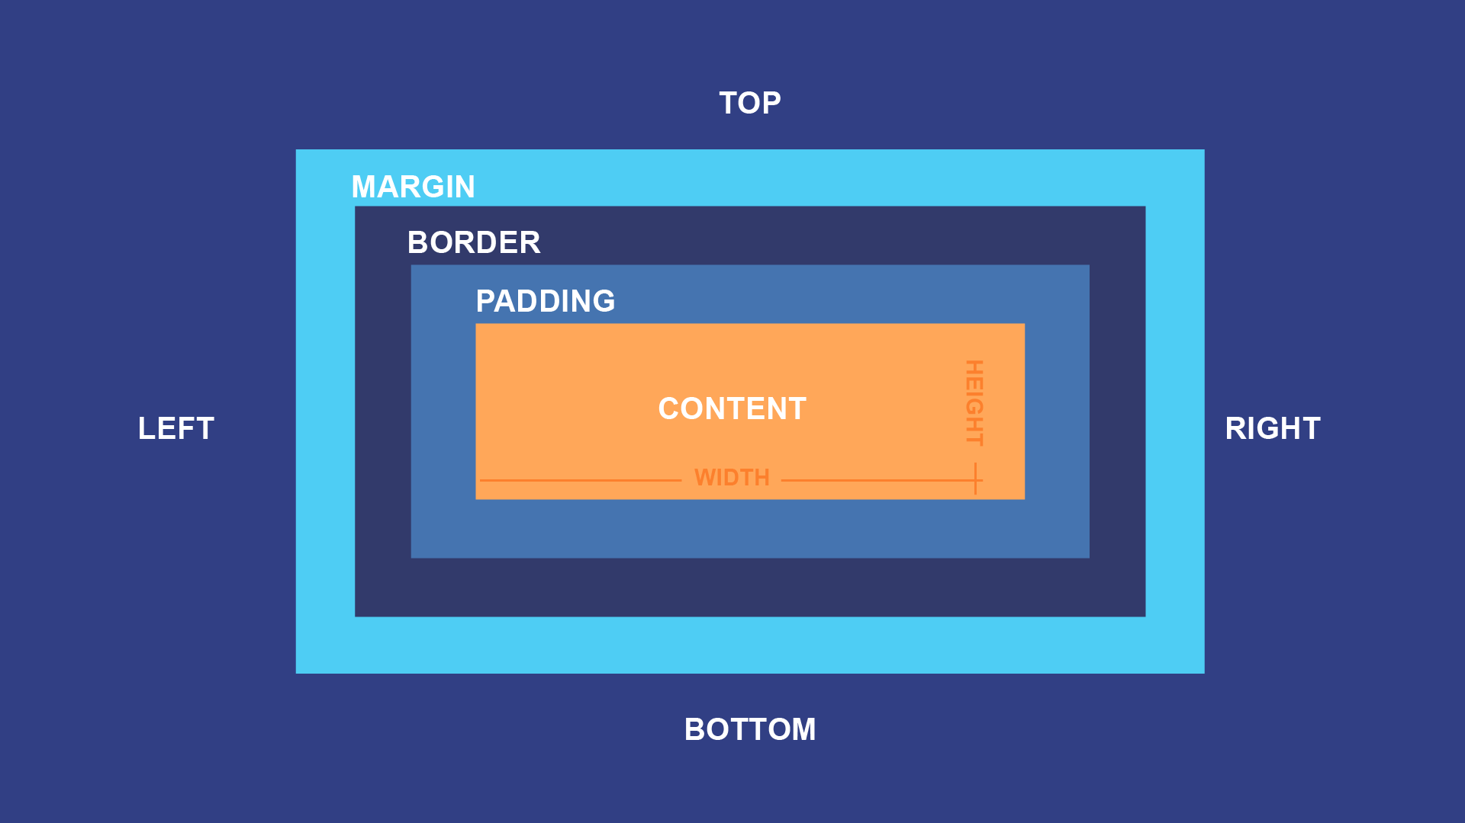
Box Model

Slide 53
Box Model
Content - The content of the box, where text and images appear
Padding - Clears an area around the content. The padding is transparent
Border - A border that goes around the padding and content
Margin - Clears an area outside the border. The margin is transparent

Slide 54
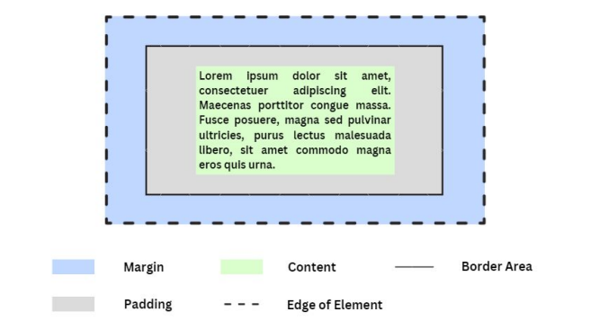
Box Model

Slide 55
Box Model
Projects

Slide 56

Quick Question
How to make layouts?

Slide 57
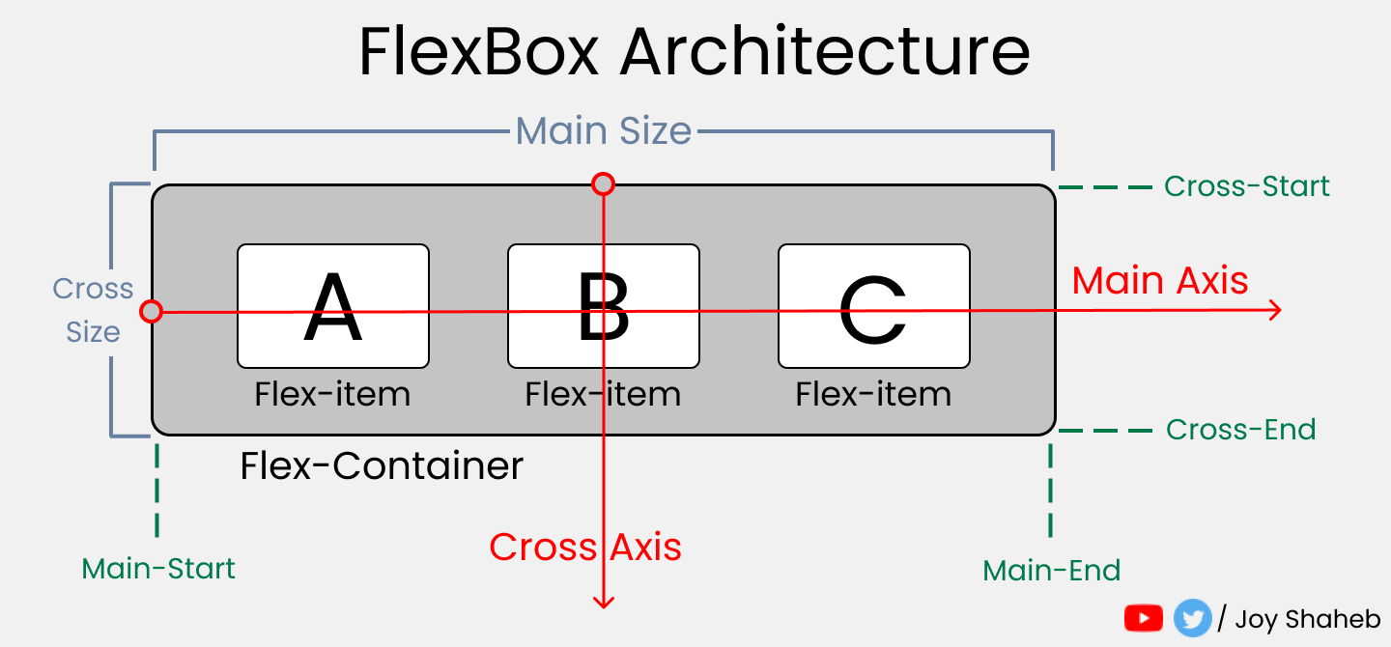
Flexbox
Flexbox is for making structured layouts for arranging content in our web.
It is just like a blueprint for a building.

Slide 58
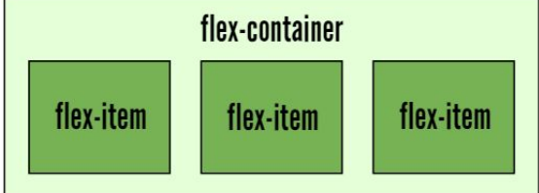
Flexbox
Flexbox is a flexible box that can be used to set up element with container.

Slide 59
Flexbox Properties
display : flex
flex-direction : row | column | row-reverse | column-reverse
justify-content : flex-start | flex-end | space-around | space-between | center
align-content : flex-start | flex-end | space-around | space-between | center

Slide 60
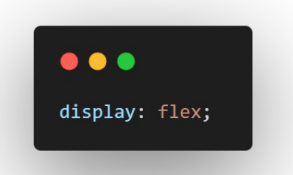
How to use?
Used for making the layout

Slide 61
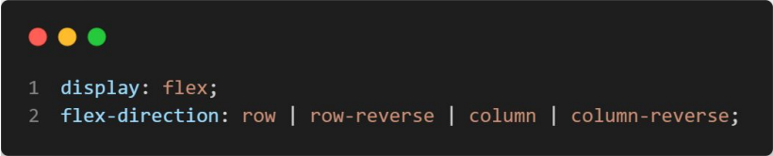
Direction

Slide 62
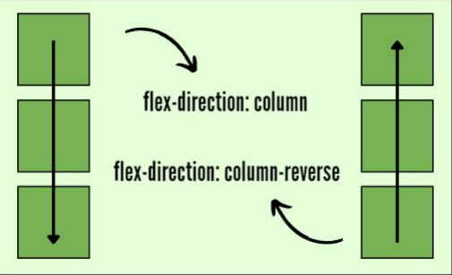
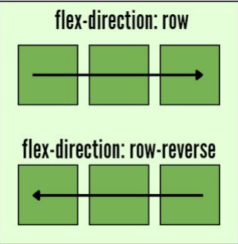
Direction

Slide 63
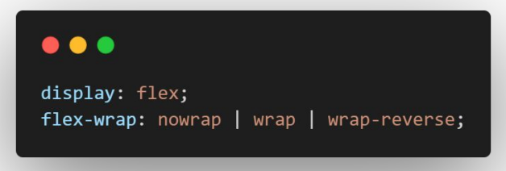
Wrap
For wrapping the elements

Slide 64
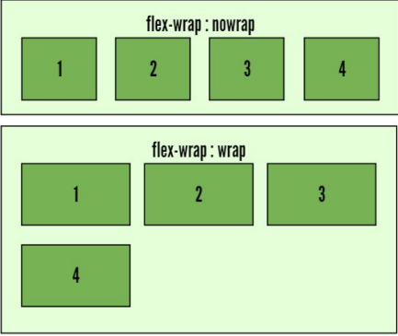
Wrapping

Slide 65
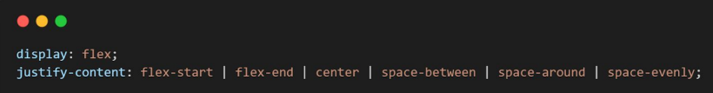
Justify Content
For justifying or aligning the content horizontally. (ROW)
For justifying or aligning the content Vertically. (col)

Slide 66
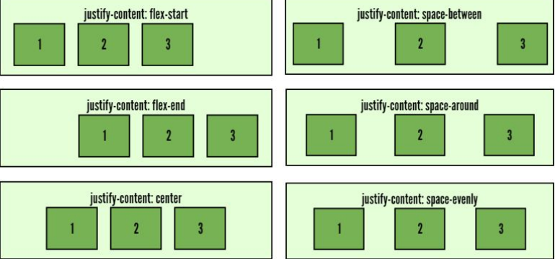
Justify Content

Slide 67
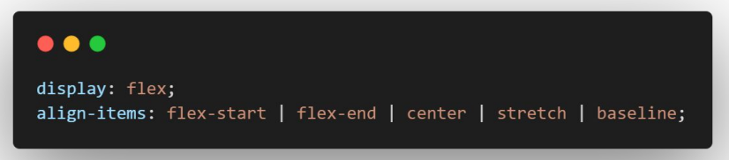
Align Items
For justifying or aligning the content vertically.

Slide 68
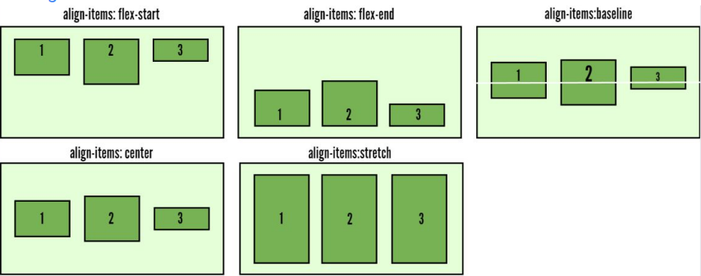
Align Items

Slide 69
Animations
We can animate our elements using some styles.
An animation lets an element gradually change from one style to another.
You can change as many CSS properties you want, as many times as you want.
To use CSS animation, you must first specify some keyframes for the animation.

Slide 70
KeyFrames
When you specify CSS styles inside the keyframe rule, the animation will gradually change from the current style to the new style at certain times.
To get an animation to work, you must bind the animation to an element.

Slide 71
Properties
Property | Function
animation-duration | Set the duration to complete
animation-delay | Delay before start
animation-timing-function | Specify the speed curve

Slide 72
Responsive Web Design
  Responsive web design makes your web page look good on all devices.
  Web pages can be viewed using many different devices: desktops, tablets, and phones. Your web page should look good, and be easy to use, regardless of the device.
  Web pages should not leave out information to fit smaller devices, but rather adapt its content to fit any device:

Slide 73

Responsive Web Design

Slide 74
Media Queries
  @media all and (max-width : 600px)
  {
  /* CSS Styles */
  }

Slide 75
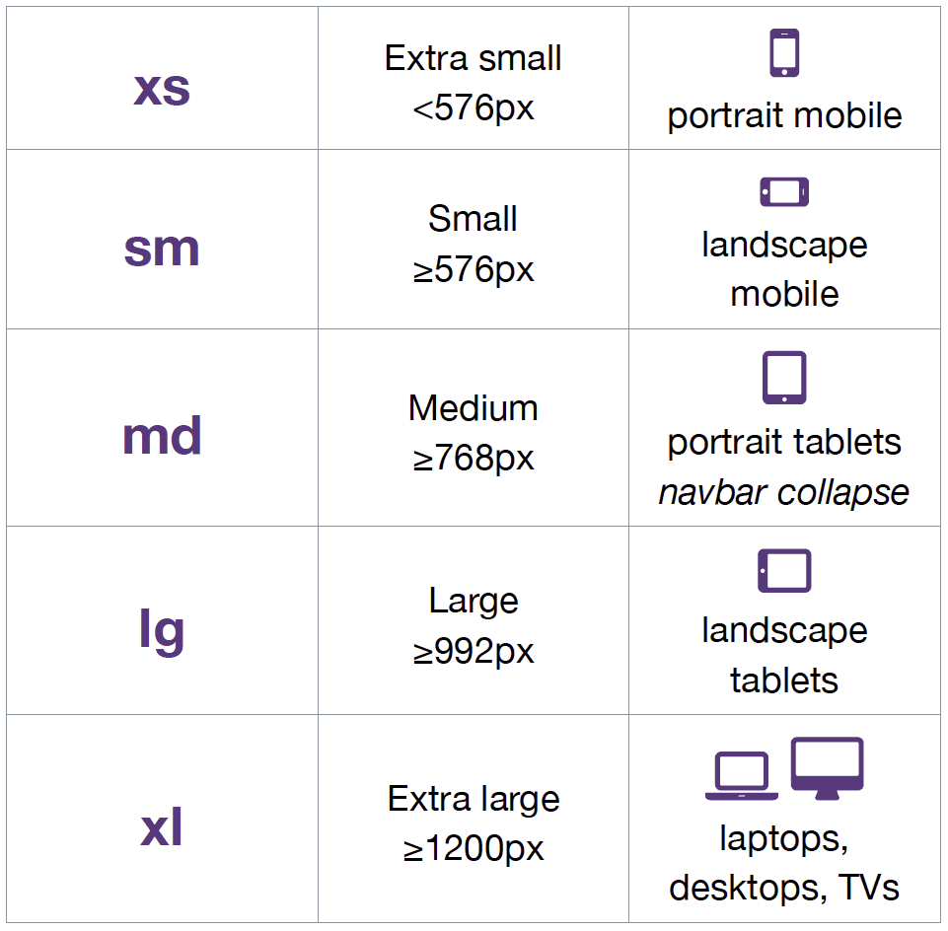
Media Queries

Slide 76
Root Variables
  The var() function is used to insert the value of a CSS variable.
  CSS variables have access to the DOM, which means that you can create variables with local or global scope, change the variables with JavaScript, and change the variables based on media queries.
  We will use :root for making variables in css.
  :root {
  --blue: #1e90ff;
  --white: #ffffff;
  }

Slide 77

Projects
  It’s Time to
  do Projects

Slide 78
JavaScript
Programming Language

Slide 79

JavaScript
What do you know about coding?

Slide 80
JavaScript
JavaScript is a high-level, object-oriented, multi-paradigm programming language. 🤯
Let’s Recall

Slide 81
JavaScript

Slide 82
JavaScript
Developers use JavaScript to build complex interactive websites and browser games, and to connect servers to websites and web applications
We can dynamically update content, control multimedia, animate images, and pretty much everything.

Slide 83
JavaScript
JavaScript is a high-level, object-oriented, multi-paradigm programming language.
Programming Language: Language that tells computers what to do.
High Level: Can be used by multiple paradigms.

Slide 84
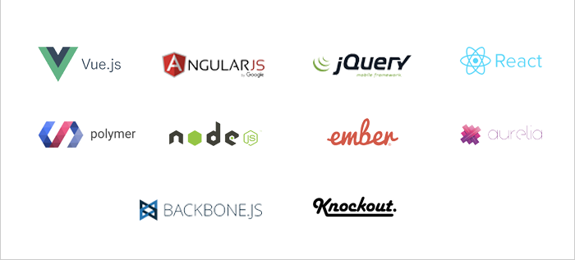
Roles
JavaScript can be used:
  Dynamic web applications using frameworks

Slide 85
How To write Real JS?
We can write JavaScript in our web applications using script tags. (Embedded)
We can write JavaScript code in an separate file and link that file.

Slide 86
How to Print?
In JavaScript, you can use the console.log() method to print something to the console.
console.log("Hello, World!");
When this code is executed, the message "Hello, World!" will be printed to the console. This is a useful tool for debugging and testing your code, as you can print out values and check the output in real-time.

Slide 87
Values & Variables
Value is basically a piece of data. A most fundamental unit in an application.
For exp:
  “Talha” is a value.
  212 is a value
  It is the smallest unit of information.

Slide 88
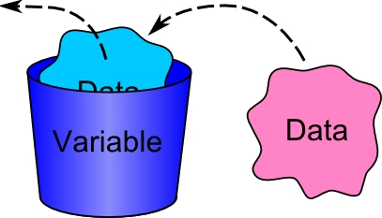
Variables
We can store values in variables.

Slide 89
Variables
Variables can be declared using three keywords.
let
var
const
We can reassign and change variables data in case of let & var, but not in case of const.

Slide 90
Variables
Rules for writing Names of Variables.
Descriptive, specific and meaningful.
Names can be written using Camel Case.
Can be written including letters, numbers, but not start with number.
No special characters are allowed.
Avoid using keywords or reserved words as variable names

Slide 91
Comments
Comments are a way to add notes and explanations to the code. They are ignored by the interpreter and do not affect the execution of the program.
There are two types of comments:
  Single Line Comments
  Multi-Line Comments
Both types of comments are ignored by the interpreter and are not executed. They can be used to explain the code, to disable parts of the code temporarily, or to leave notes for other developers

Slide 92
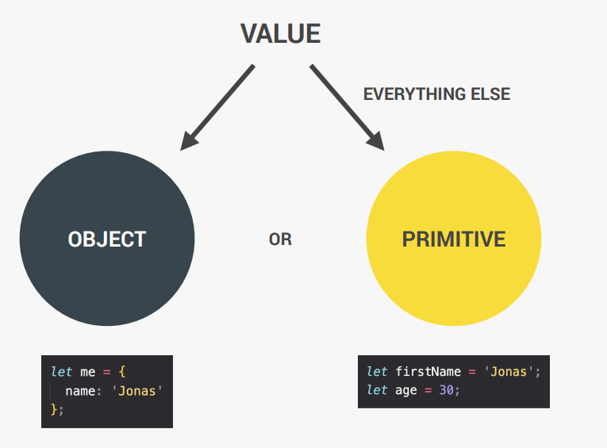
Data Types
  We have already learned about values.
  Values can be of different types.

Slide 93
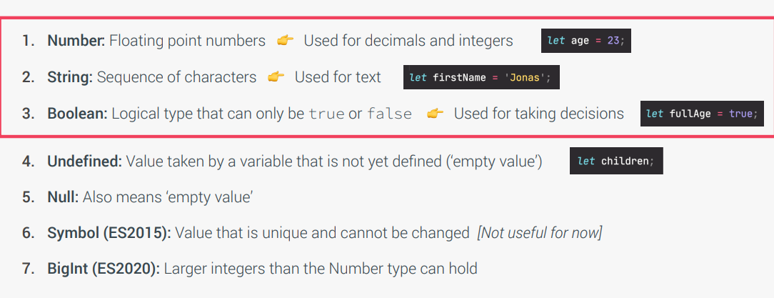
Data Types

Slide 94
JS Behaviors
  JavaScript has dynamic typing: We do not have to manually define the data type of the value stored in a variable. Instead, data types are determined automatically.

Slide 95
JS Operators
  We can do every type of operation with our data types.
  Add | Minus | Multiply | Divide | Conditions

Slide 96
Strings
JavaScript strings are used to represent text and are enclosed in single or double quotes.
Let’s Make our introduction in code.

Slide 97
Strings Literals
  It is just like the simple strings. The main benefits of using string literals is that they are easy to read and understand in the code. They also allow for easy string concatenation and interpolation.
  Example:
  let age = 22;
  let intro = `Talha age is ${age}`

Slide 98
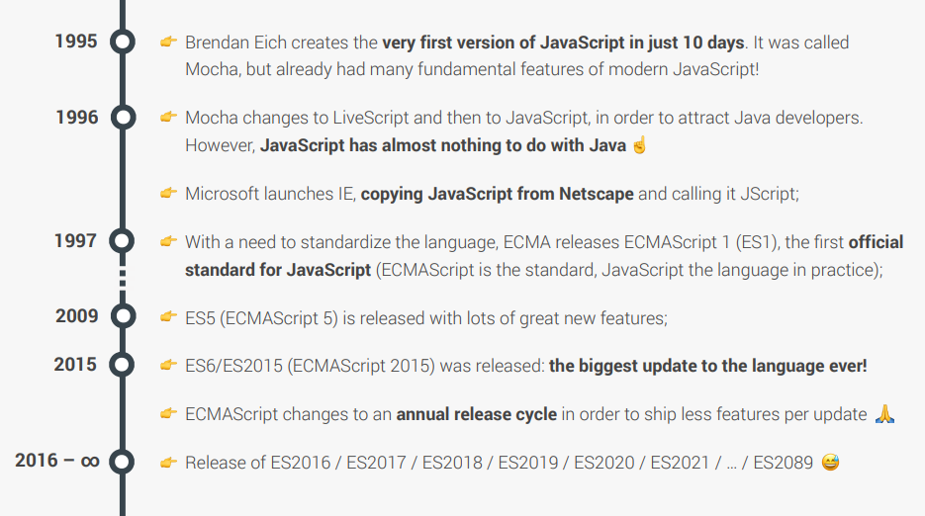
History of JS

Slide 99
Conditional
  Conditional statements are used to make decisions in JavaScript.
  The most common is “if-else” statement.
  The if statement is used to execute a block of code if a certain condition is met. The else statement is used to execute a block of code if the condition is not met.
  The condition is a Boolean expression that can be evaluated to true or false. It can be a comparison operator, logical operator, or a function that returns a Boolean value.

Slide 100
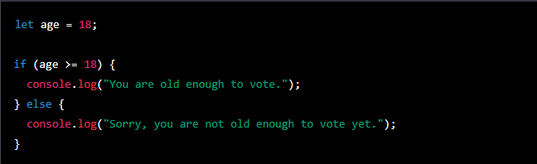
Conditional

Slide 101
Logical Operators
There can be multiple conditions in if else block.
We have to use nested if-else conditions to meet that objectives.
The second thing that we can do is to use logical operators.
There are mainly three logical operators.
&& - And Operator
| | - Or Operator
! - Not Operator

Slide 102
History of JS
From Now, We are going to
learn advanced JavaScript.

Slide 103
Repetition
JavaScript provides several ways to repeat a block of code multiple times
For loop: The for loop is used to execute a block of code a specified number of times. It typically consists of three parts:
  Initialization statement
  Condition
  Increment/decrement statement.

Slide 104
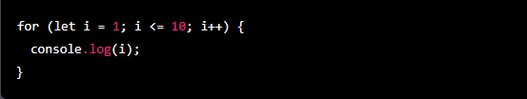
Repetition

Slide 105
Repetition
Your task is to explore the others types of loops as well.

Slide 106
Loops
Let’s Play with Loops?

Slide 107
Tips
  For solving any problem, we need to do following things:
  Make sure you 100% understand the problem. Ask the right questions to get a clear picture of the problem
  Don't be afraid to do as much research as you have to
  For bigger problems, write pseudo-code before writing the actual code

Slide 108
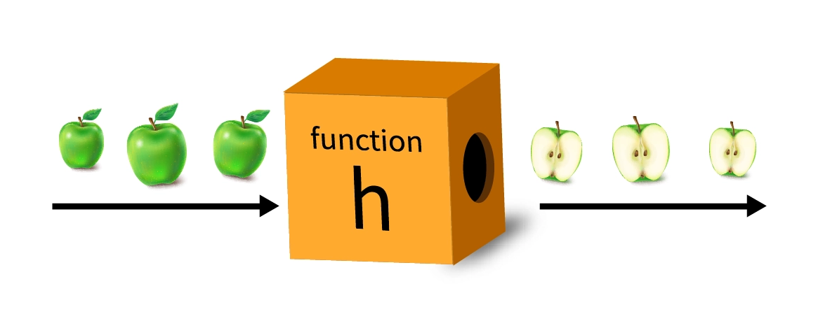
Functions
In JavaScript, a function is a block of code that can be executed multiple times. Functions can take input in the form of arguments and can return output in the form of a return value. Functions can also be used to organize and structure code, making it more readable and maintainable.

Slide 109
Functions
  There are three ways to make functions:
    Declaration Functions
    Expression Functions
    Arrow Function

Slide 110
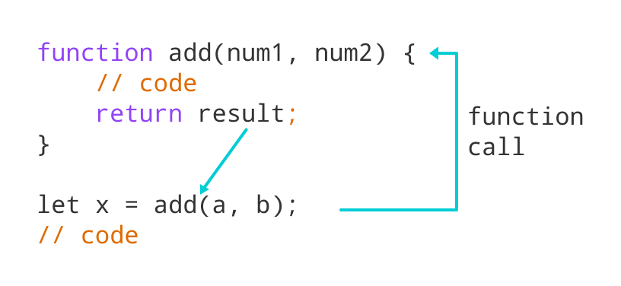
Declaration Function

Slide 111
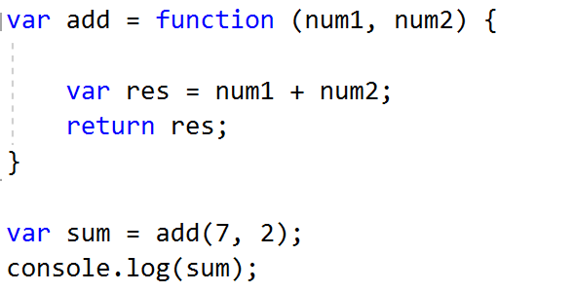
Expression Function

Slide 112
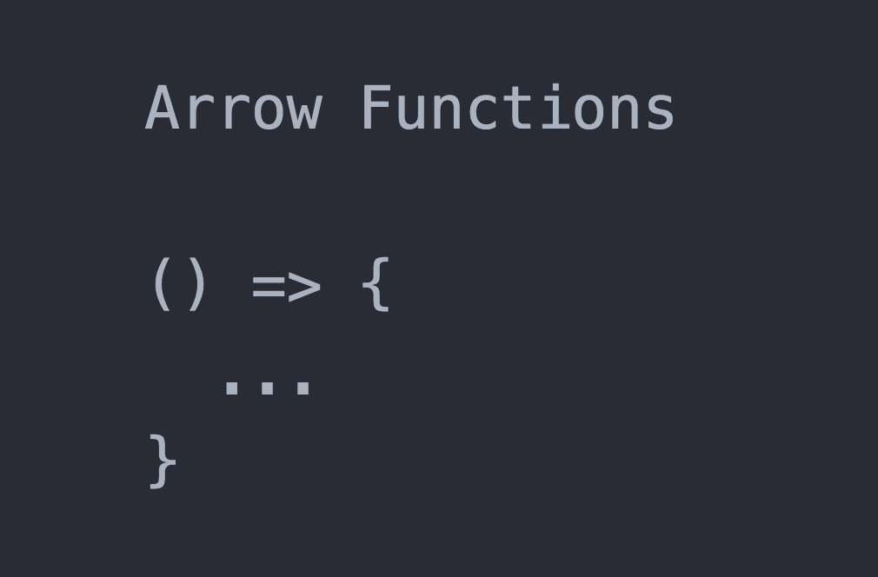
Arrow Function

Slide 113
Functions
We can use functions to do many exciting things.
Functions calling another Function

Slide 114
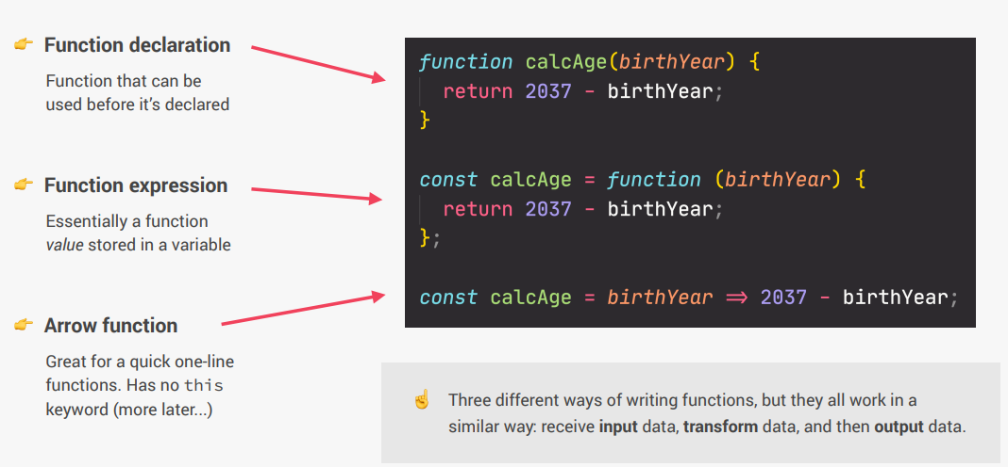
Functions

Slide 115
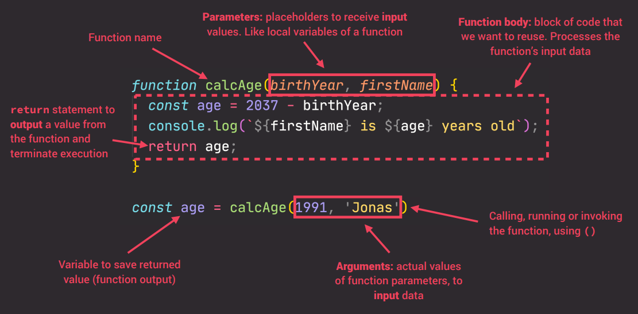
Functions

Slide 116
Arrays
Let’s first discuss about a Problem?

Slide 117
Arrays
Arrays are a fundamental data structure in JavaScript that allows you to store a collection of items in a single variable.
Each item in an array is called an element, and each element can be of any data type, including numbers, strings, Booleans, and even other arrays.
Arrays are created by enclosing a list of elements in square brackets, with each element separated by a comma.
let numbers = [1, 2, 3, 4, 5];

Slide 118
Arrays
How to Access?
You can access individual elements of an array using their index, which is a zero-based number indicating the position of the element in the array. For example, the first element of the "numbers" array would be accessed using the following code.
let firstNumber = numbers[0];
Arrays can have multiple data types in it.

Slide 119
Arrays
Arrays Methods
Arrays have a variety of built-in methods that allow you to manipulate the elements, such as adding and removing elements, sorting, and searching
push() : which allows you to add an element to the end of an array.
pop() : which removes the last element of an array.
unshift() : which allows you to add an element to the beginning of an array.
shift() : which removes the first element of an array.
sort() : which sorts the elements of an array.
indexOf() : which returns the index of the first occurrence of a specified element in an array.

Slide 120
Objects
Objects in JavaScript are similar to arrays in that they allow you to store a collection of data, but unlike arrays, they use key-value pairs to store data
Each key is a string and each value can be of any data type, including numbers, strings, booleans, and even other objects.

Slide 121
Objects
let person = {
name: “Talha",
age: 30,
isStudent: false,
friends : [‘Ans’, ‘David’]
};

Slide 122
Objects
How To Manipulate Data?
There are two ways to access or manipulate data:
Dot notation
Bracket Notation
let personName = person.name;
let personName = person["name"];

Slide 123
Objects
Methods
Objects can also have methods, which are functions that are associated with an object.
These methods can be used to perform operations on the object's data.
We can access methods by using both dot and bracket notation.

Slide 124
DOM
  The Document Object Model (DOM) is a programming interface for HTML.
  The DOM is a fundamental concept for web development and it's important to understand how to interact with it in order to build dynamic and interactive websites.
  Document object model: struc tured representation of html documents. Allows JavaScript to access html elements and styles to manipulate them

Slide 125
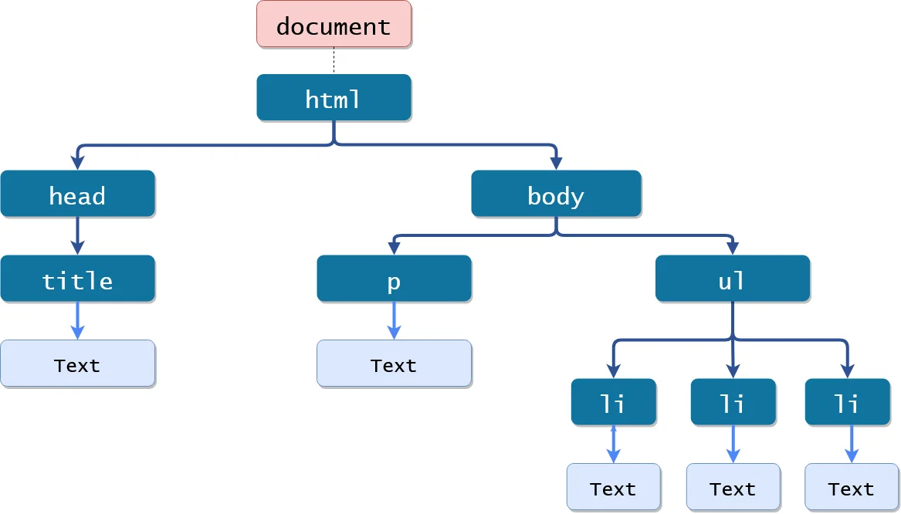
DOM

Slide 126
DOM
  With the DOM, you can:
    Access and change the content of an element
    Access and change the attributes of an element
    Add, remove, or move elements and attributes
    Respond to events that occur in the document, such as a button being clicked or a form being submitted

Slide 127
DOM
  Now, we’re going to access HTML elements in JS.
  JavaScript provides these methods for accessing elements:
  By ID
  getElementByID(id)
  let myElement = document.getElementById("myId");
  By Class
  getElementsByClassName(className)
  let myElements = document.getElementsByClassName("myClass");

Slide 128
DOM
  By Class Method 2
  querySelector(selector)
  let myElement = document.querySelector(".myClass p");

Slide 129
DOM
Manipulating elements in the DOM is a key aspect of working with the Document Object Model (DOM). JavaScript provides several methods for manipulating elements in the DOM.

Slide 130

DOM
Changing the content of an element: You can use the innerHTML property to change the content of an element. For example:

Slide 131

DOM
Changing the attributes of an element: You can use the setAttribute method to change the value of an attribute.

Slide 132
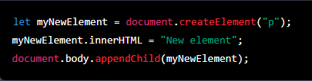
Manipulation
Adding elements to the DOM: You can use the createElement method to create a new element and the appendChild method to add it to the DOM. For example:

Slide 133

Manipulation
Removing elements from the DOM: You can use the removeChild method to remove an element from the DOM. For example:

Slide 134

Manipulation
Changing the style of elements: You can use the style property to change the style of an element. For example:

Slide 135

Manipulation
You can also use classList property, to add, remove or toggle a class to an element and thus change its style

Slide 136

Manipulation
It's important to note that, manipulating elements can cause changes in the layout of the webpage, and thus affect the user experience, so its recommended to be careful and test the changes before deploying them.

Slide 137
Event Listeners
Events and event listeners are a key aspect of client-side web development, and are used to respond to user interactions and other events that occur in the browser.
An event is an action or occurrence, such as a button click, a page load, or a form submission, that can be detected by JavaScript. An event listener is a function that is called in response to a specific event.

Slide 138
Event Listeners
JavaScript provides several methods for working with events and event listeners.
Event listeners are a powerful tool for creating dynamic and interactive websites. They allow you to respond to user interactions and other events in a way that is both efficient

Slide 139
Event Listeners
addEventListener
This method allows you to attach an event listener to an element. It takes two arguments: the type of event to listen for and the function to be called when the event occurs
let myButton = document.getElementById("myButton");
myButton.addEventListener("click", myFunction);

Slide 140

Fun Activity
Let’s Make a Game

